Slide 1


DESIGN 1
Lesson 3: Independent Application: Formatting Your Own Content
Ms. Abboud • Grade 9 - Design 1 • Term 1, Week 3

Slide 2
Learning Objectives
WALT - We Are Learning To
WILF - What I'm Looking For
Independently structure and format original content for your personal website.
Apply heading hierarchy, paragraphs, and text formatting purposefully.
New content is original, organized logically, and uses correct heading hierarchy.
Formatting tags (<strong>, <em>) are used on purpose, not randomly.

Slide 3
Frayer Model: Hierarchy (Review)
DEFINITION
CHARACTERISTICS
An ordered structure from most to least important, used to describe how heading levels organize a page.
h1 is biggest/most important; levels get smaller as they matter less; never skip a level (e.g. h1 straight to h4).
HIERARCHY
EXAMPLES
NON-EXAMPLES
<h1>My Website</h1>
<h2>About Me</h2>
<h2>My Hobbies</h2>
<h1>My Website</h1>
<h4>About Me</h4>
(skips h2 and h3)

Slide 4
National Identity Integration
Effective Digital Communication: writing and structuring your own original content, not just following a template, is exactly how real Emirati organizations build a professional digital presence.

Slide 5
STARTER
What's Missing From Your Site?
What's one section you want on your personal website that we haven't built yet?
e.g. Hobbies, Goals, Favorite Projects - jot down 1-2 ideas.
Hook • Engage & Ask
5 - 10 minutes

Slide 6
LESSON CORE
I Do: Today's Challenge
Choose 1-2 new content sections for your site - write and structure them yourself.
Apply <strong> and <em> purposefully to highlight key words.
Gradual Release of Responsibility
30 - 40 minutes
Example: a new section with strong, em, hr, and br
<h2>My Goals</h2>
<p>This year I want to learn
<strong>web design</strong> and improve my
<em>problem-solving</em> skills.</p>
<hr>
<h2>Favorite Subjects</h2>
<p>Design<br>Mathematics<br>Art</p>
1 / 2

Slide 7
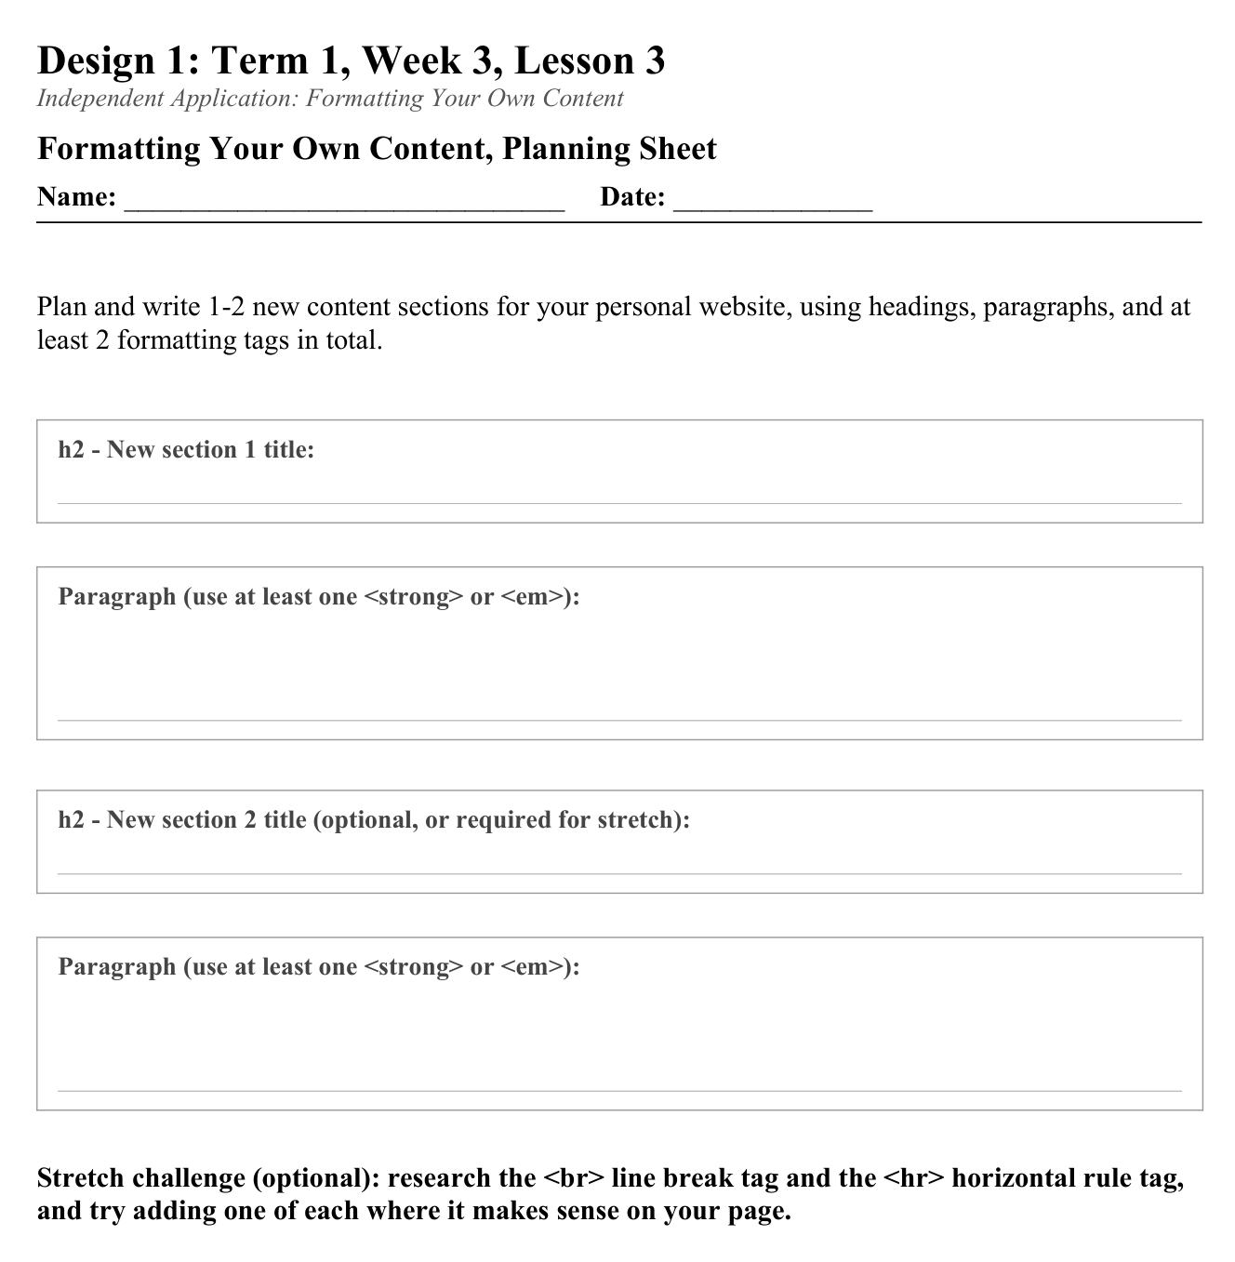
LESSON CORE
You Do: Plan & Build
Add 1-2 new, fully formatted sections using correct headings, paragraphs, and 2+ formatting tags.
Stretch: research and try <br> (line break) and <hr> (horizontal rule).
Activity: Formatting Your Own Content, Planning Sheet
Gradual Release of Responsibility
30 - 40 minutes
2 / 2

Slide 8
CLOSURE
Teacher Circulation
No formal exit ticket today - teacher circulates for 1:1 feedback on structure and formatting choices.
Early finishers: try the stretch challenge (<br> and <hr>).
Transition & Extend
5 - 10 minutes

